Slide 1

Traffic Accidents Analysis End-to-End Data Analytics Project
- By Asma Khan

Slide 2

SQL Problem Statements
SQL Questions :-
How many accidents occurred per year/month/day?
Which day of the week has the highest number of accidents?
At what hour do most accidents occur?
Count of accidents by most_severe_injury
What percentage of accidents involved fatalities (injuries_fatal)?
Average number of injuries per crash.
Which prim_contributory_cause appears most frequently?
Accidents by weather_condition (rain, snow, clear).
Accidents by lighting_condition (daylight vs dark).
Top 5 most common first_crash_type.
Which traffic_control_device (e.g., stop sign, signal) is most associated with accidents?
Accidents at intersections vs non-intersections.
Average num_units per crash.
what is the damage cost of the accidents

Slide 3
Power BI Problem Statements:-
Show accidents over time (trend by year, month).
Accidents by day of week and hour of day
Breakdown of accidents by Injury type.
Visualize accidents by weather condition
Show top causes from primary contributor of accidents.
Top first_crash_type accidents.
Accidents by roadway type
Accidents by roadway_surface_cond (dry, wet, icy).
Identify peak risk hours and days of the week.

Slide 4
Dataset Overview and Tools used :-
Dataset Overview :-
• Name: Traffic Accidents Dataset
• Size: 2,09,307 rows
• Features: 24 columns
• Purpose: Used for analysis of accident patterns and trends
Tools Used:-
Python – for data cleaning
SQL – for EDA and analysis
Power BI – for visualization

Slide 5
Key Metrices
Total
Total Accidents - 209k
Average
Average accidents per day - 15.73
Average
Average accidents per year – 2.02k

Slide 6
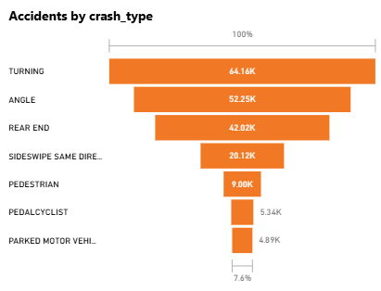
Distribution of Accidents by Crash Type
Insights:
This funnel chart indicates that most accidents happen during turning (64K) and angle (52K).
Rear-end collisions (42K) are also a major cause.
Pedestrian and cyclist accidents are fewer but still significant for safety planning.
Focused road design and awareness campaigns at turning points can reduce accident severity.
Recommendation:
Install better turn signals and improve lane guidance at high-turning zones.

Slide 7
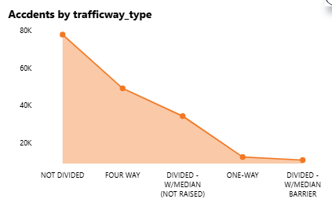
Accidents by Trafficway Type
Insights :-
Highest number of accidents occur on undivided roads, indicating poor lane separation and higher collision chances.
Four-way and divided (not raised) roads also have a significant number of accidents.
One-way and divided roads with median barriers record the least accidents, showing that proper road division and traffic flow management reduce risks.

Slide 8
Actionable Recommendations :-
Traffic Safety Campaigns:
Conduct awareness drives and enforce strict monitoring on Fridays and weekends when accidents peak.
Infrastructure Improvements:
Install speed breakers, reflective signboards, and better road lighting at high-risk areas.
Policy-Level Measures:
Implement data-driven traffic management, focusing on years/locations with consistently high accident rates.
Emergency Response Readiness:
Strengthen emergency medical response systems for non-incapacitating and incapacitating injuries.
Weather & Time-Based Analysis :
Use the dashboard filters to study accidents under specific weather or months — plan preventive measures accordingly.

